Slide 1
High-Level Design of a Distribution Microgrid
Senior Design Team 11
Website: https://sddec18-11.sd.ece.iastate.edu/
Client: Alliant Energy
Darin Lamos and Logan Heinen of the Distribution Engineering Department
Faculty Advisor: Professor James McCalley

Slide 2
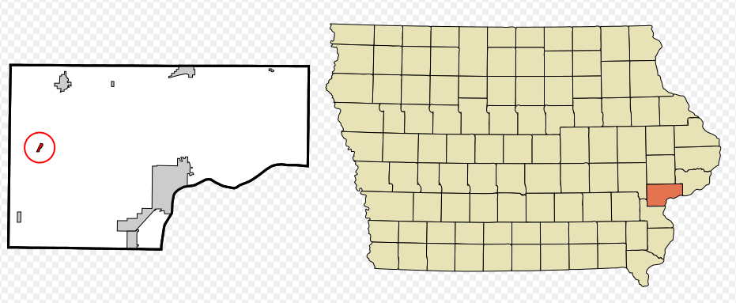
Team 11: High-Level Design of a Distribution Microgrid
Project Plan - Problem Statement
Alliant Energy has tasked our team with creating a spreadsheet that will calculate the amount of distributed energy needed to meet the kWh demands of a small town in Iowa. This town is miles from the grid and requires long transmission lines to provide power to the town, so it might be more cost effective to create a microgrid in Nichols.
Population: 374
Peak Demand: 630 kVA for 3 hours
Total Annual Load: 2,231 MVA
Fed via grid interconnection

Slide 3
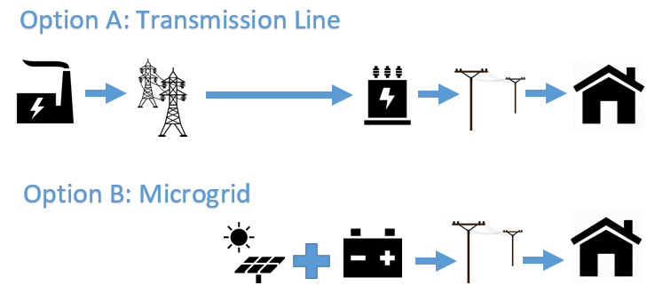
Team 11: High-Level Design of a Distribution Microgrid
Project Plan - Conceptual Sketch

Slide 4
Team 11: High-Level Design of a Distribution Microgrid
Project Plan - Functional Requirements
The simulation of the electric system shall include solar radiation, generation, and load
The solar panel generation and batteries must provide power with minimal load interruption (5% of peak demand)
The spreadsheet will identify the ideal quantity of solar panels and batteries required to meet a user defined portion of the load (80%, 90%, 100%)
The spreadsheet will include hourly demand calculations

Slide 5
Team 11: High-Level Design of a Distribution Microgrid
Project Plan - Non-Functional Requirements
Spreadsheet type deliverable
Visual representations of load demand, generation, and battery supply
Simulation able to run for at least a year of data
Show all calculations and work in a separate tab
Condense all important information together

Slide 6
Team 11: High-Level Design of a Distribution Microgrid
Project Plan - Technical Constraints/Considerations
The final deliverable shall be in the form of an excel spreadsheet
The only sources of power for the microgrid shall be solar panels and batteries
Supplemental generators are available for demand not met

Slide 7
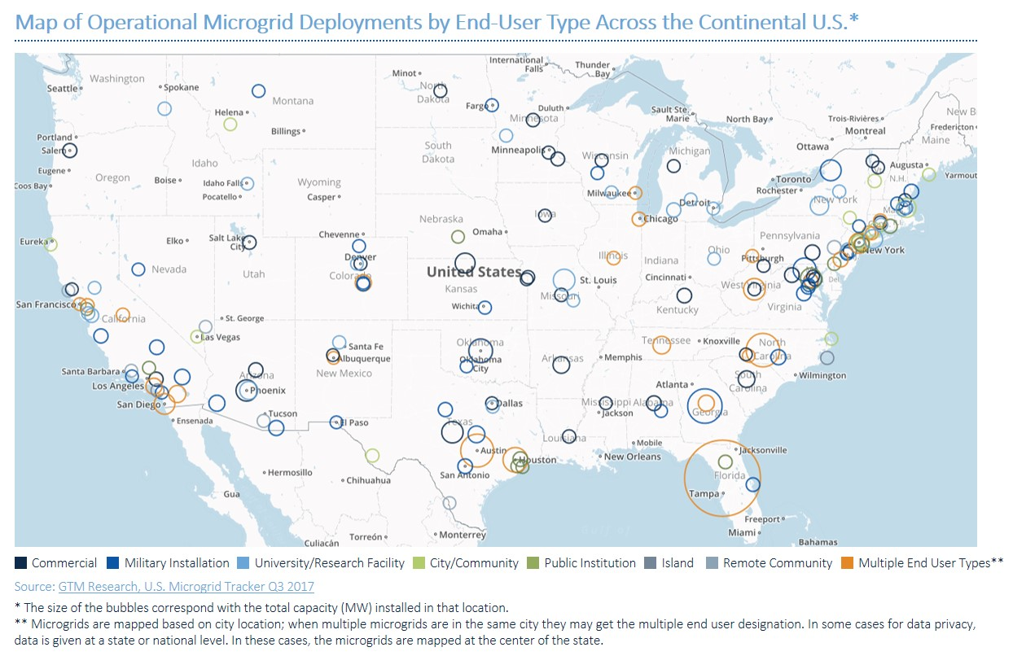
Team 11: High-Level Design of a Distribution Microgrid
Project Plan - Market Survey
Few island microgrids
Evolving Photovoltaic technology
Remote towns require long transmission lines
Figure 1

Slide 8
Team 11: High-Level Design of a Distribution Microgrid
Project Plan - Potential Risks & Mitigation
Accuracy of future load growth and PV and battery quantities to supply the load
The growth of a town can only be estimated based on past trends and would affect the growth of the microgrid
The ratio between the quantity of PV and batteries is dependant on the weather of the microgrid location.
For example, a location with less solar radiation will require more batteries to supply the load than a location with more solar radiation.

Slide 9
Team 11: High-Level Design of a Distribution Microgrid
Project Plan - Resource/Cost Estimate
Our project does not require any funds
All necessary resources on data and technology specifications for the Nichols system is provided by Alliant

Slide 10
Team 11: High-Level Design of a Distribution Microgrid
Project Plan - Project Milestones
Initial combination of solar and battery capable of supplying enough power
Simulating the microgrid for one week, one month, one year
Implementing supplemental generation and 100%, 90%, and 80% solar supply
Future changes to system to keep up with increasing kWh demand
Use the simulation to model the environment of Nichols, Iowa and prove that the design is capable of supplying enough power to the load.
Applying cost and life cycle analysis to the designed system

Slide 11
Team 11: High-Level Design of a Distribution Microgrid
Project Plan - Schedule
Jan - Mar: Implementation of solar + battery supply of demand
Feb - Mar: Simulation model of environment and output
April: Begin developing Matlab simulation
April: User defined portion of demand supplied by solar panels
April: Finalize simulation and microgrid design, Project Plans, Design Documents, website

Slide 12
Team 11: High-Level Design of a Distribution Microgrid
System Design - Functional Decomposition
Enter input information for the simulation
Initial battery storage, month of the year, average daily kWh demand, quantity of panels, quantity of batteries
Generate Random Usage
This simulates the kWh demand for each day of a 1 month period
Generate Random Solar Days
This simulates the solar radiation for each day of a 1 month period
Print Daily Totals
This outputs all of the input and output information into tables and visuals for analysis

Slide 13
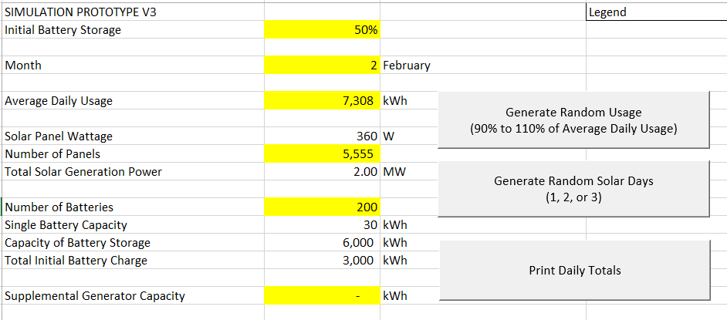
Team 11: High-Level Design of a Distribution Microgrid
System Design - Detailed Design

Slide 14
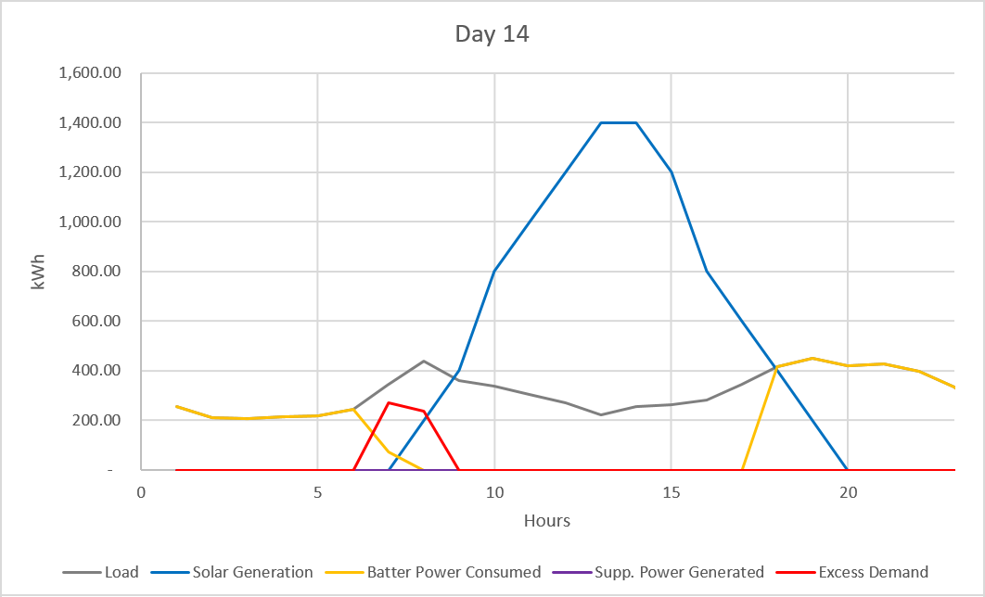
Team 11: High-Level Design of a Distribution Microgrid
System Design - Detailed Design - Daily

Slide 15
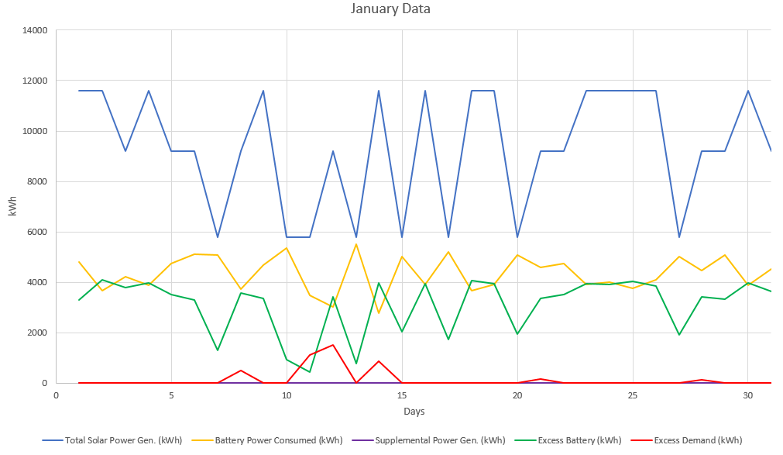
Team 11: High-Level Design of a Distribution Microgrid
System Design - Detailed Design - Monthly

Slide 16
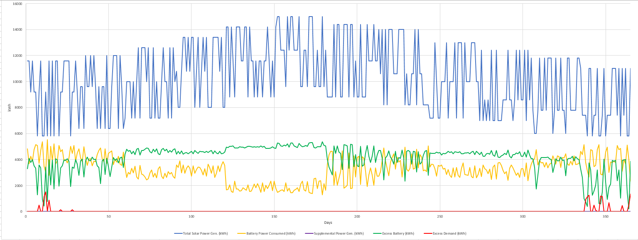
Team 11: High-Level Design of a Distribution Microgrid
System Design - Detailed Design - Yearly

Slide 17
Team 11: High-Level Design of a Distribution Microgrid
System Design - Technology
Excel VBA Macro Buttons
Generate random usage profile for the selected month: between 90% and 110% of average daily usage
Generate random solar profile for the selected month: mixture of low, medium, and high solar days
Print daily totals for selected month: compiles monthly data in a seperate tab for data analysis
Combination of these Macros easily allows the user to simulate a full year under various conditions

Slide 18
Team 11: High-Level Design of a Distribution Microgrid
System Design - Test Plan
Achieve Demand
Financial Target
Variable Solar Capabilities
Growth Simulation

Slide 19
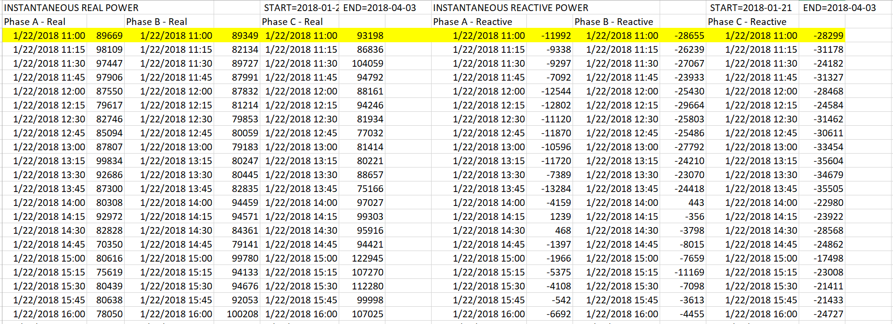
Team 11: High-Level Design of a Distribution Microgrid
System Design - Implementing Prototype -
Nichols, Iowa

Slide 20
Team 11: High-Level Design of a Distribution Microgrid
Conclusion - Current Project Status
Prototype is capable of..
Simulating environment including solar radiation and hourly kWh demand
Supplying user defined portion of load via solar panels and batteries
Conveying important information such as supplied demand and power generation visually

Slide 21
Team 11: High-Level Design of a Distribution Microgrid
Conclusion - Individual Contributions
Nick - weekly status reports, team website, project planning, test plan, design document
Joe - prototype simulation, load data, user defined supply of kWh demand
Taylor - Solar radiation and generation research, solar + battery implementation for power supply
Minoru - User interface for prototype, solar radiation and generation research, load data
Remo - Matlab simulation, load data organization, financial cost estimates

Slide 22
Team 11: High-Level Design of a Distribution Microgrid
Conclusion - Plan for Fall Semester
Aug: Apply summer data from Nichols to Spring design
Aug: Update Spring prototype
Aug - Sep: Finalize Matlab simulation tool
Sep- Nov: Design system to accommodate for demand growth
Nov - Dec: Apply microgrid design to locations across the US
Nov - Dec: Finalize Senior Design project/ quantity and financial estimations

Slide 23
Team 11: High-Level Design of a Distribution Microgrid
Conclusion – Questions?

Slide 24
Sources
Team 11: High-Level Design of a Distribution Microgrid
Figure 1: Metelitsa, Colleen. “U.S. Microgrids 2017: Market Drivers, Analysis and Forecast.” U.S. Microgrids 2017: Market Drivers, Analysis and Forecast | Greentech Media, Nov. 2017

